Slide 1
Content Driven News Feed (Team Tigers)

Slide 2
Introduction
In this project we have made a web based text editor that receives news feed from the top notch knowledge websites based upon the instantaneous content which is in it. The overall system consist of a web based text editor in which when the text is edited, the news feed is dynamically loaded from online sources. Secondly we’ve built a middleware on flow based programming tool called Node-Red and built web services that scraps content from the top search engines, Wikipedia and videos from youtube dynamically through Ajax.

Slide 3
Approach
We have used an online web service ‘TextRazor’ through which we get the relevant topics from the current text in the editor. The topics received are fed to other web services that crawls through the knowledge sites and brings in html based results.
The results are parsed using custom Javascript based parsers for each knowledge site as each of them has different nesting of contents inside their main page body.
The results are formatted and then URL, Description of each of them is extracted.
The results are stored in firebase NoSql database for future ranking of the results.

Slide 4
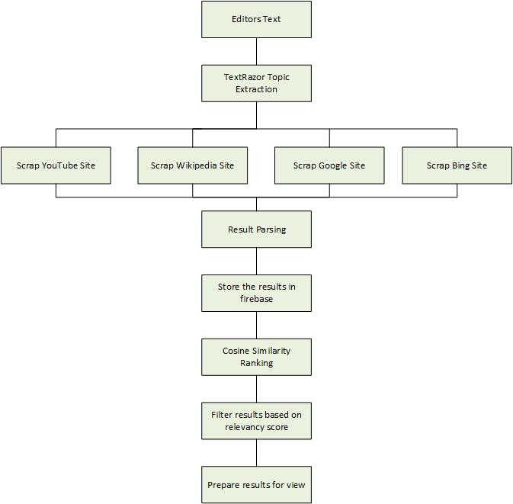
Workflow

Slide 5
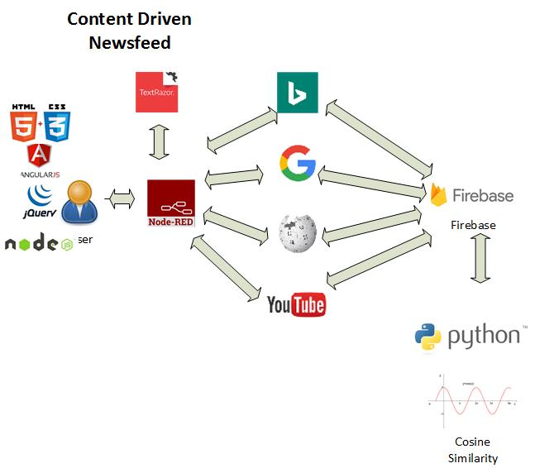
Architecture

Slide 6
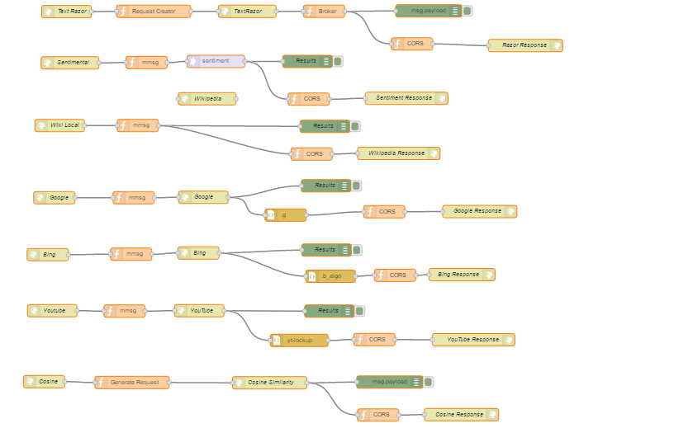
Webservice – Infrastructure Node-Red

Slide 7
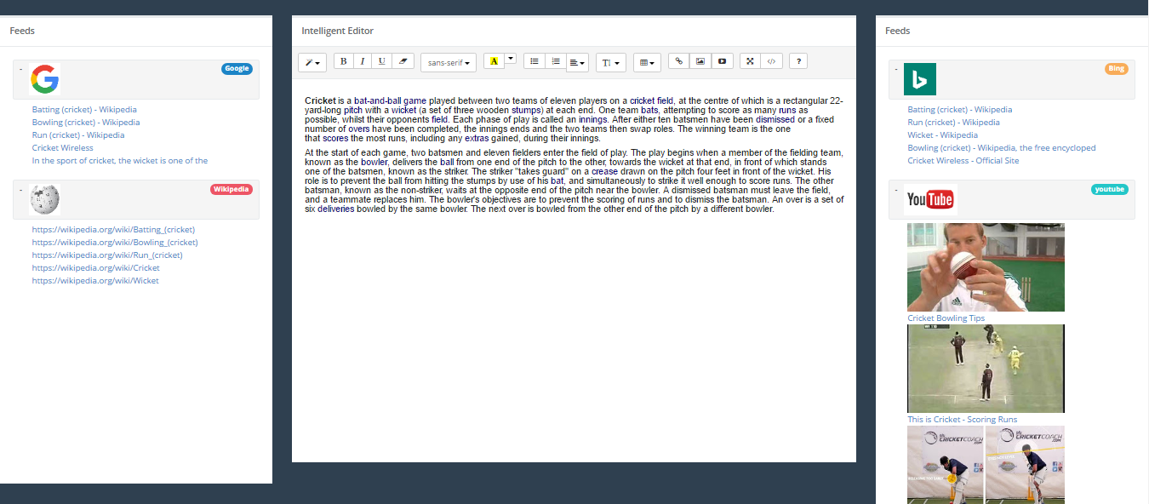
User Interface

